Slide 1
Postfix to fully parenthesized infix expression Multiple Stacks Linear Queue Circular Queue
30-OCT-2021

Slide 2
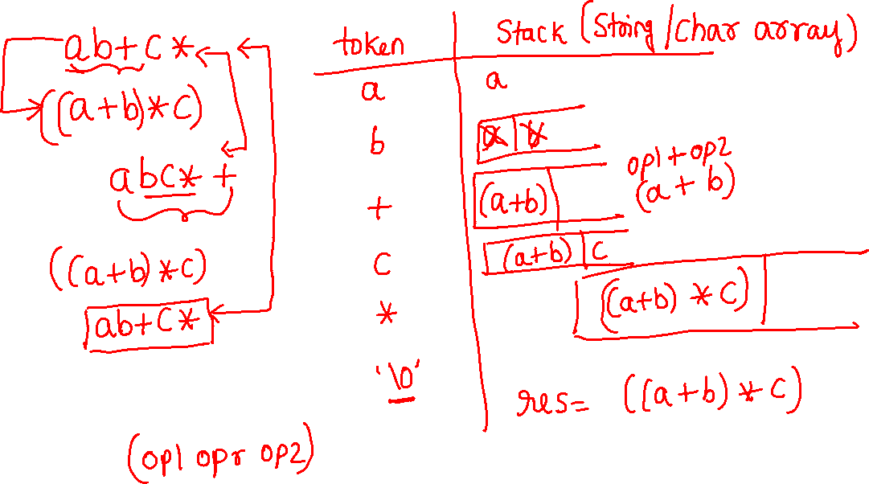

Slide 3
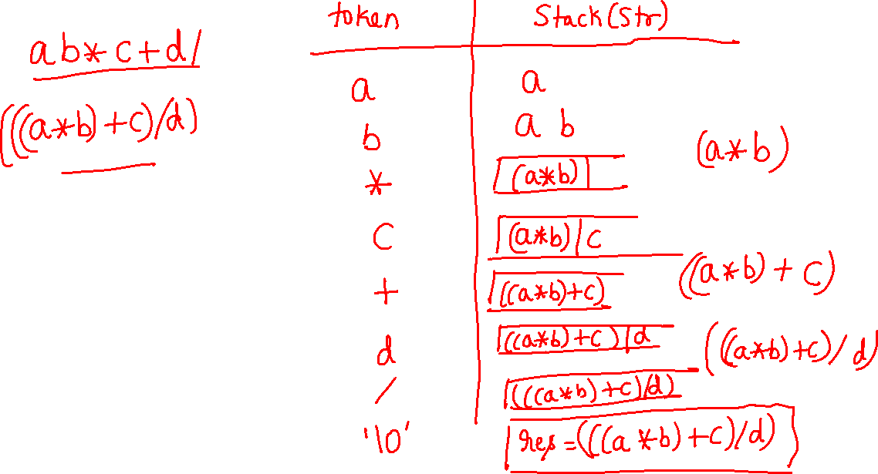

Slide 4
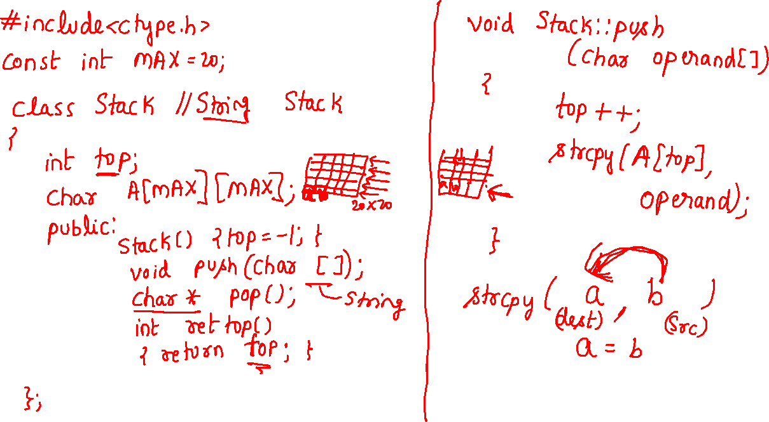

Slide 5
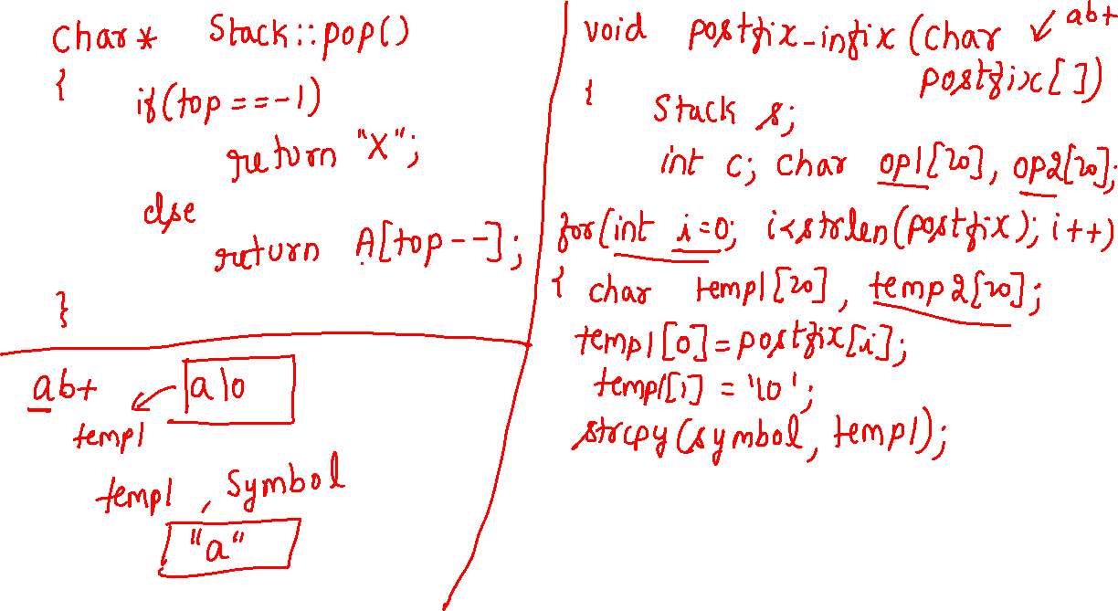

Slide 6
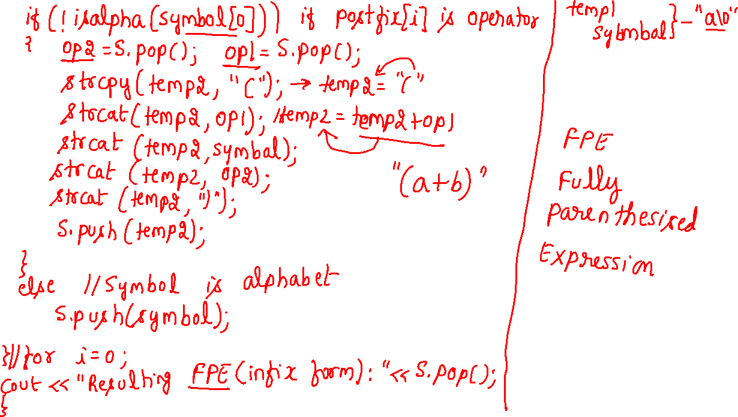

Slide 7
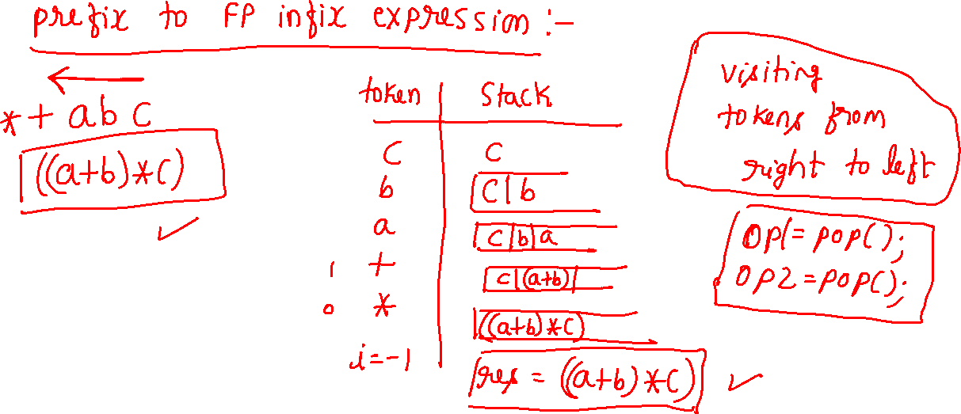

Slide 9
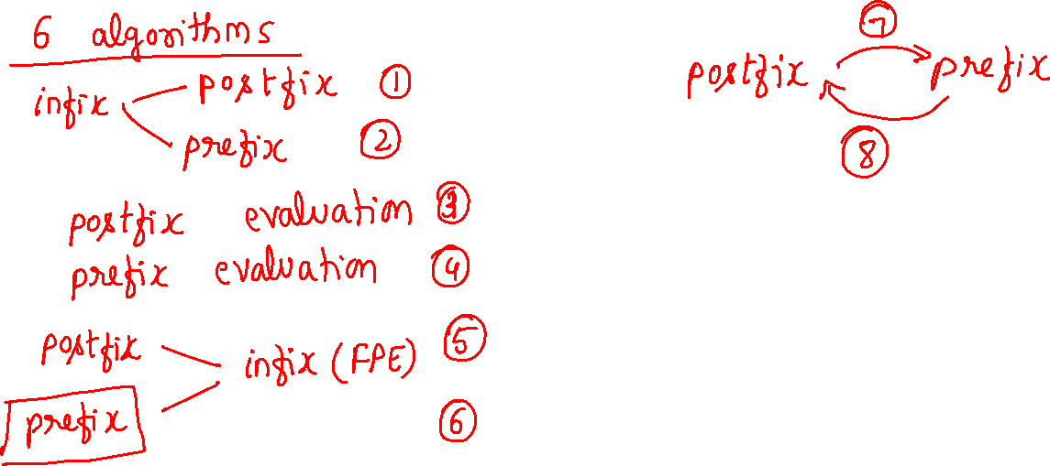

Slide 10
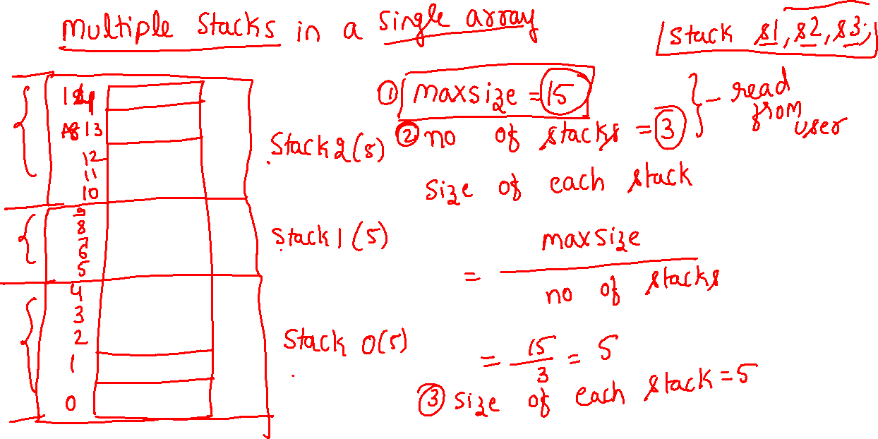


Slide 11
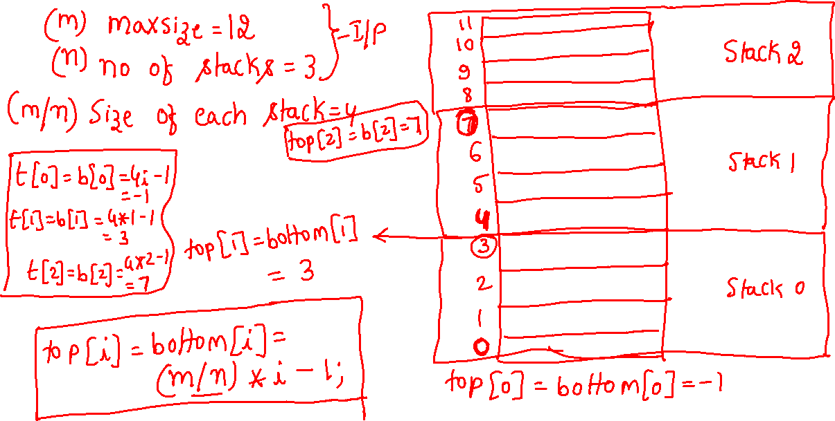
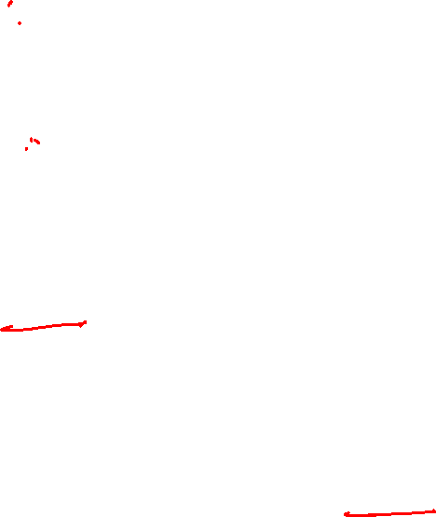

Slide 12
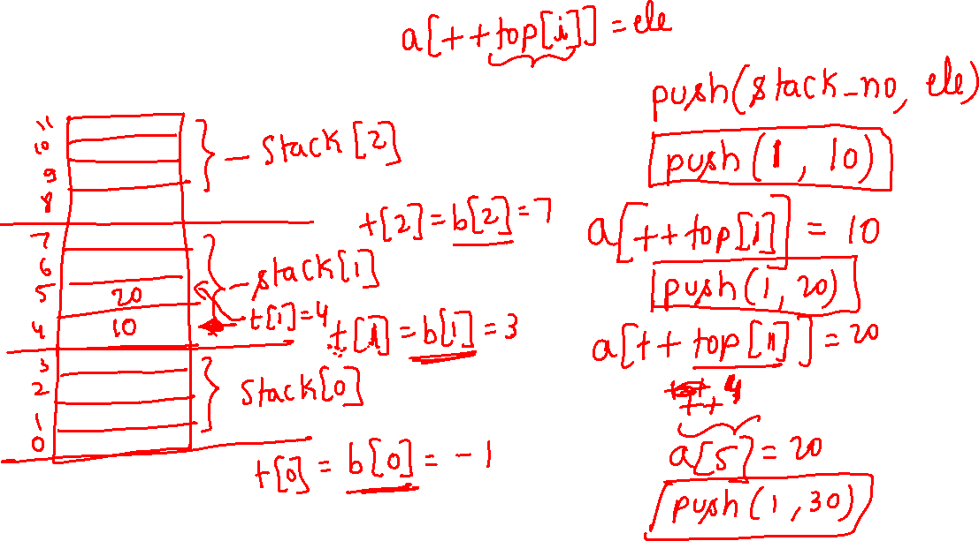

Slide 13
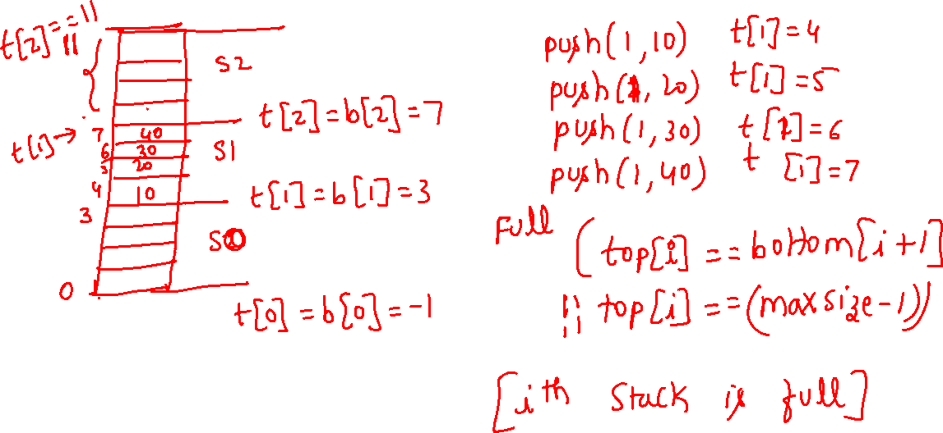

Slide 14
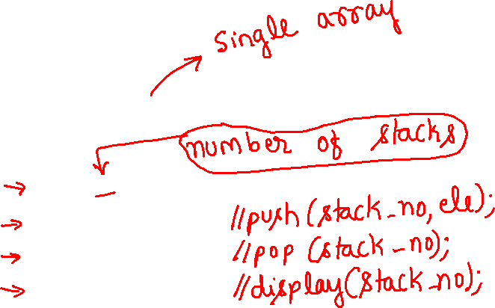
Multiple stacks(case n>=3)
#include<iostream>
using namespace std;
#define max_size 20
class stack
{
int top[10], a[50], bottom[10];
public:
stack(int);
void push(int ,int);
void pop(int);
void display(int);
};
Notes:
https://www.geeksforgeeks.org/efficiently-implement-k-stacks-single-array/

Slide 15
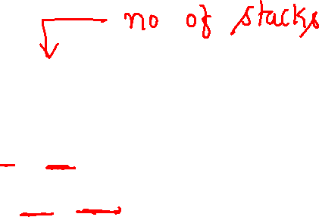

stack::stack(int n)
{
for(int i=0;i<n;i++)
bottom[i]=top[i]=(max_size/n)*i-1;
}

Slide 16
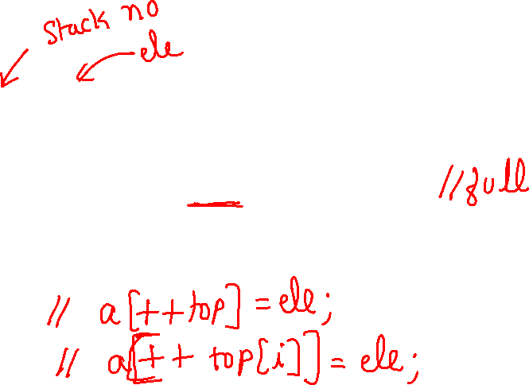
void stack::push(int i,int x)
{
if((top[i]==bottom[i+1])||(top[i]==(max_size-1)))
cout<<"Stack is full \n";
else
a[++top[i]]=x;
}

Slide 17
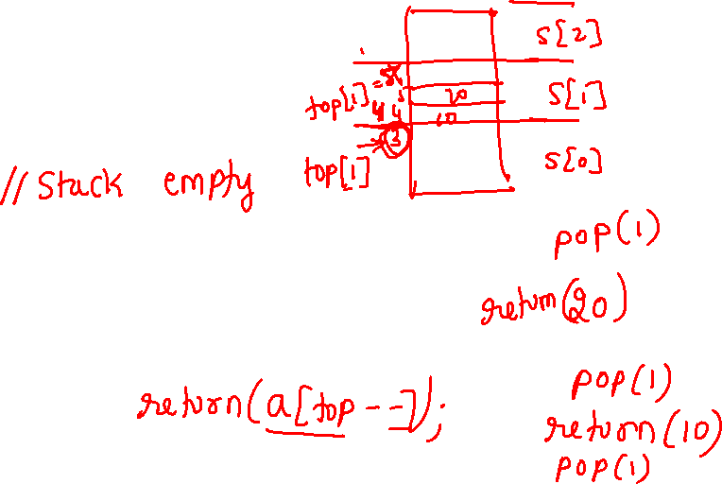
void stack::pop(int i)
{
if(top[i]==bottom[i])
cout<<"stack is empty\n";
else
cout<<"deleted element is "<<(a[top[i]--]);
}

Slide 18
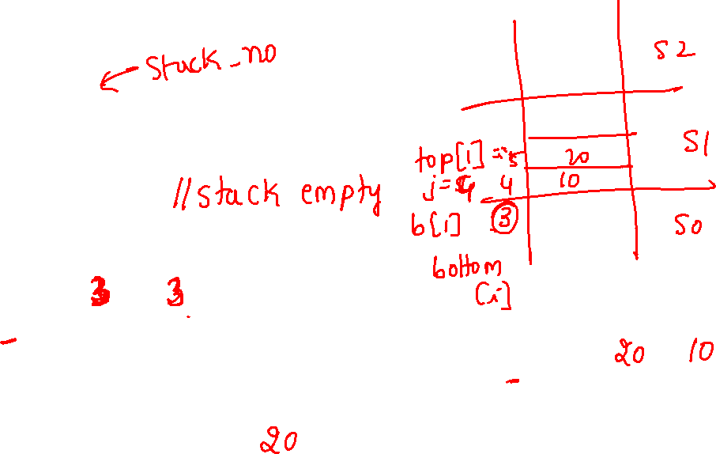
void stack::display(int i)
{
if(top[i]==bottom[i])
cout<<"stack is empty\n";
else
for(int j=top[i];j>bottom[i];j--)
cout<<"\nThe elements of stack are "<<"\n"<<a[j];
}

Slide 19
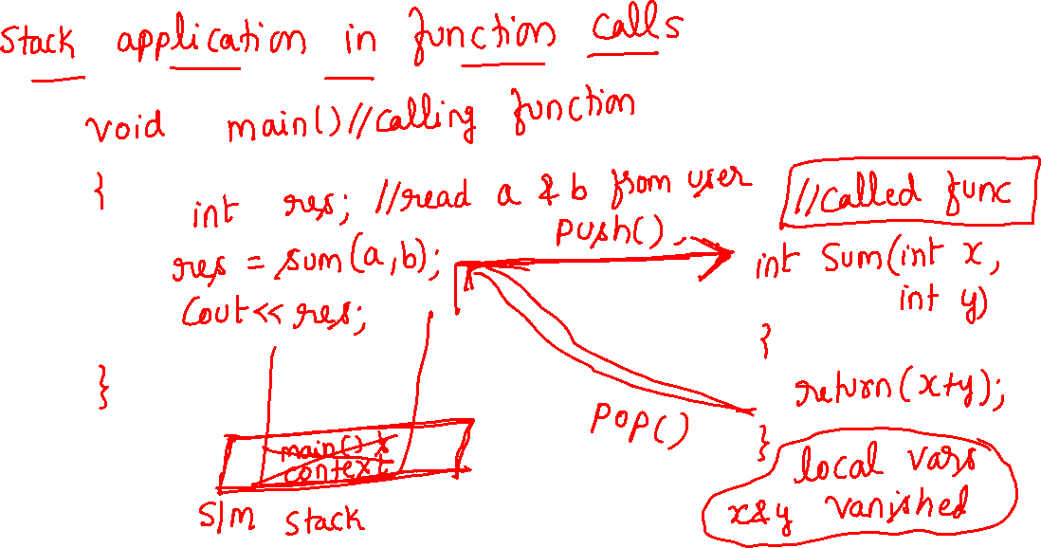

Slide 20
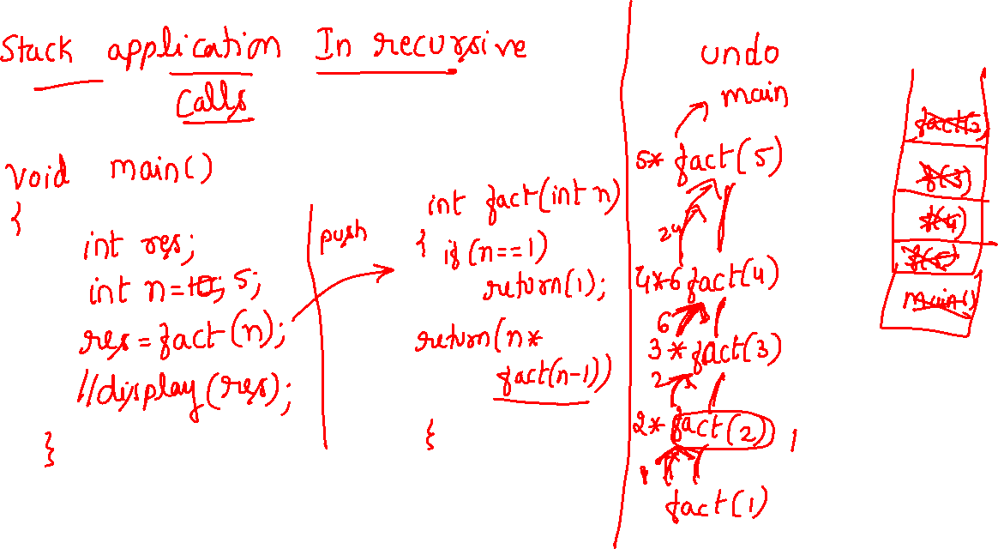

Slide 21
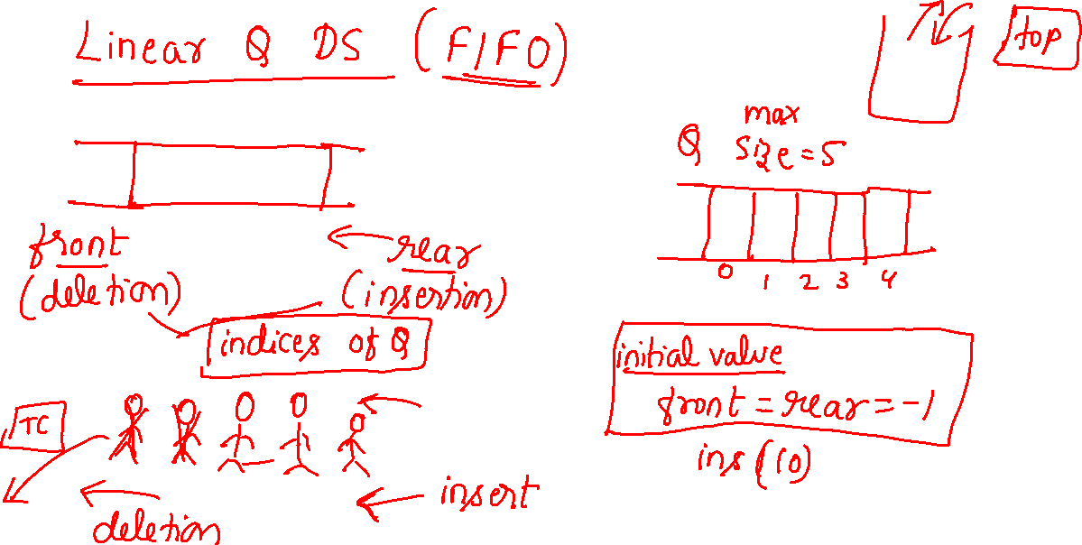

Slide 22
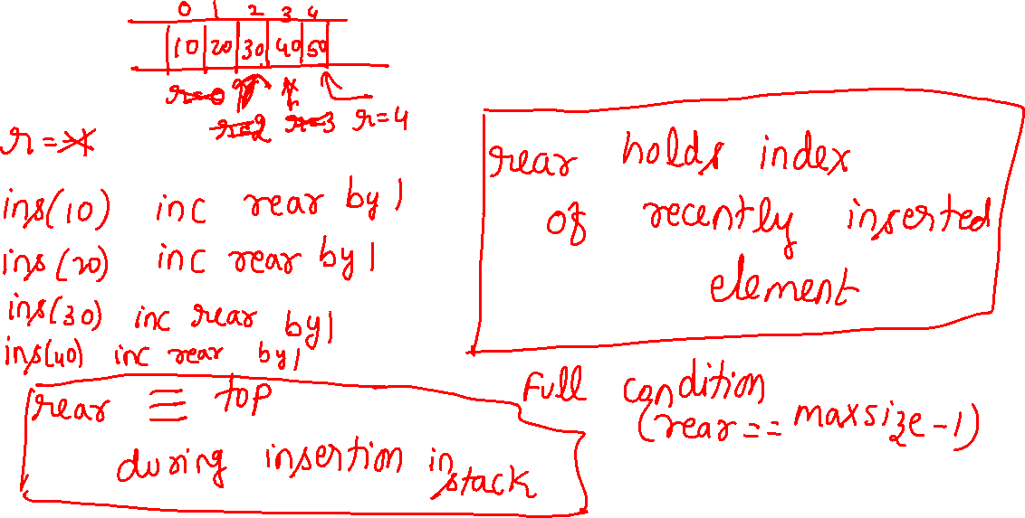

Slide 23
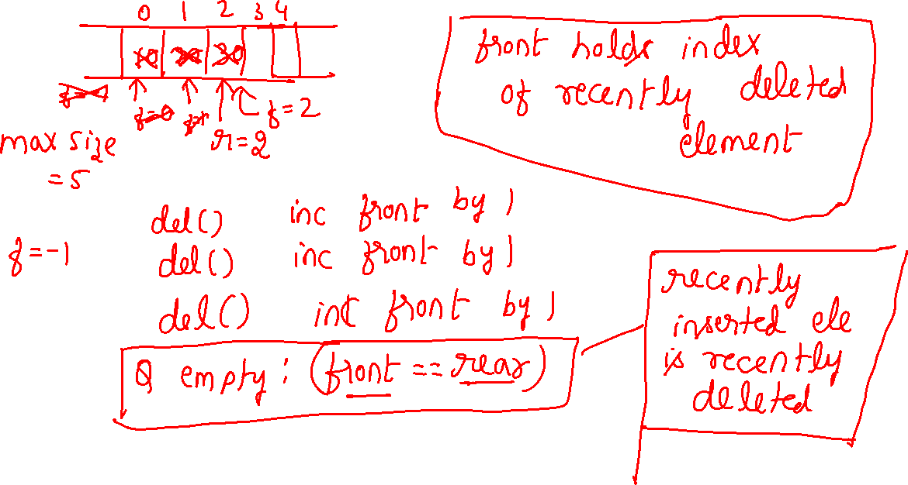

Slide 24
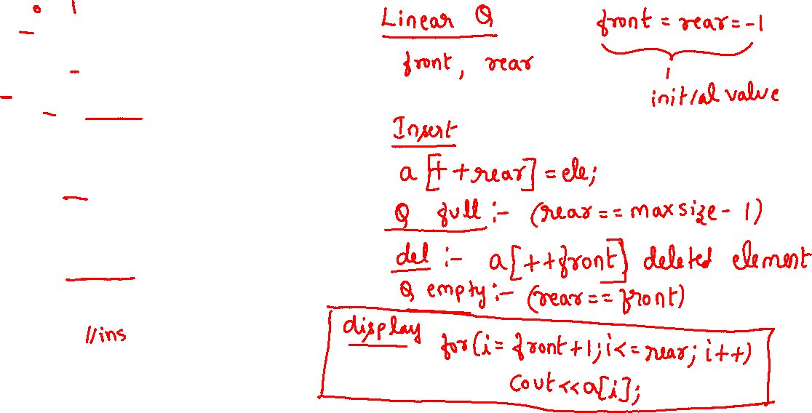
Liner Queue : Queue.cpp 1/3
Queue.cpp
#include<iostream.h>
#include<conio.h>
enum Boolean{FALSE,TRUE};
class queue
{ int front,rear, a[10], maxsize;
public: queue()
{ maxsize=4;front=rear=-1;}
Boolean Isfull()
{
if(rear==maxsize-1) return TRUE;
return FALSE;
}
Boolean Isempty()
{ if(rear==front) return TRUE;
return FALSE;
}
void add(int x);
void del();
void display();
};

Slide 25
Liner Queue : Queue.cpp 2/3
void queue::add(int x)
{ if(Isfull())
cout<<"Queue is full \n";
else
a[++rear]=x;
}
void queue::del()
{
if(Isempty())
cout<<"queue is empty\n";
else
cout<<"deleted element is"<<(a[++front]);
}
void queue::display()
{ if(Isempty())
cout<<"Queue is empty\n";
else
for(int i=front+1;i<=rear;i++)
cout<<a[i];
}

Slide 26
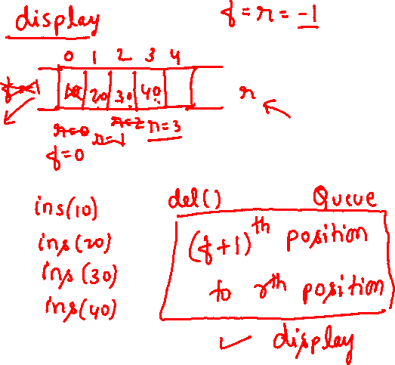

Liner Queue : Queue.cpp 3/3
void main()
{ queue s;
int option,ele;
char ch;
do{
clrscr();
cout<<"1.Insert\n2.Delete\n3.display\n4.exit\n";
cin>>option;
switch(option)
{
case 1: cout<<"enter the element to be pushed\n";
cin>>ele; s.add(ele);
break;
case 2: s.del();
break;
case 3: s.display();break;
}
}while(option<4);
}

Slide 27
Circular Queue
Can be implemented in two ways
With Counter (uses counter variable to keep track of number of elements in circular queue)
CQ with counter empty condition (counter==0)
CQ with counter full condition (counter==maxsize)
Without Counter

Slide 28
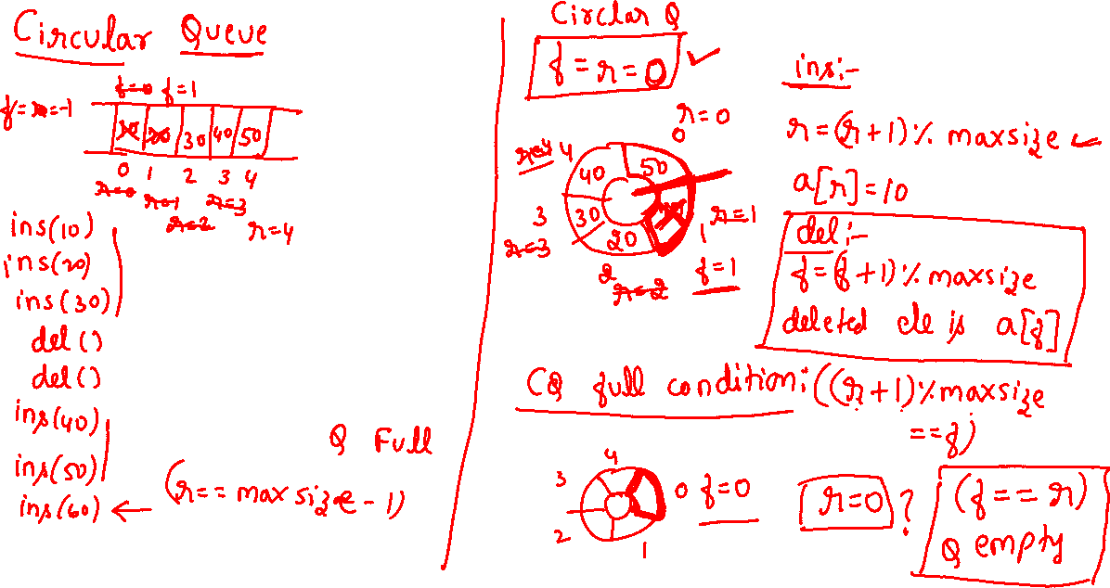
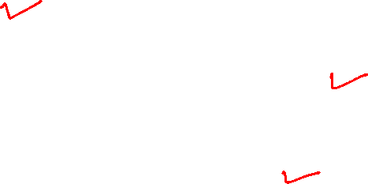

Slide 29
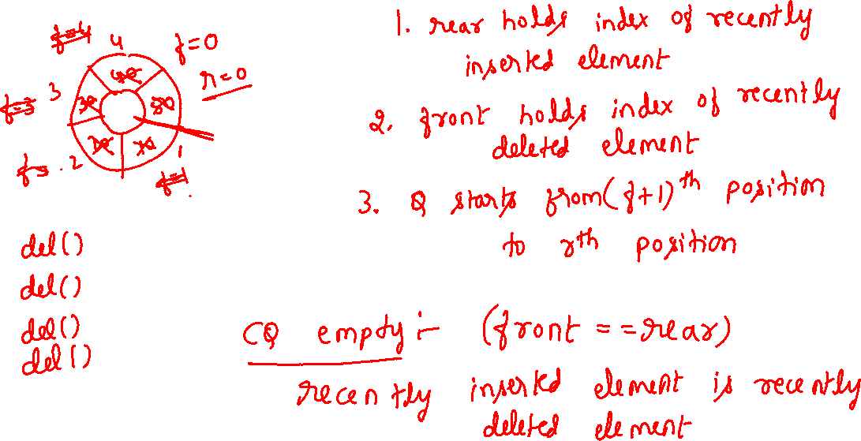
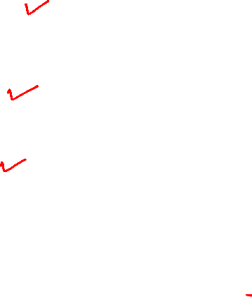

Slide 30
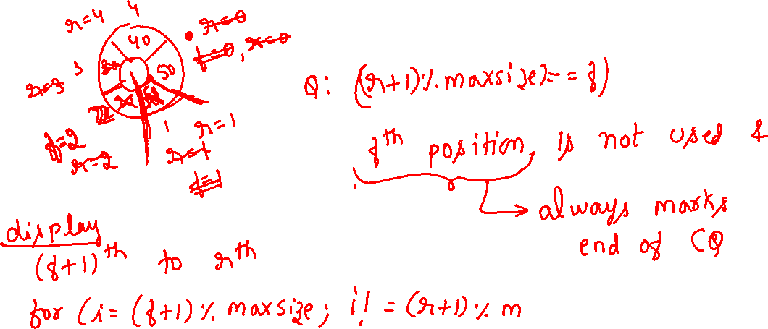
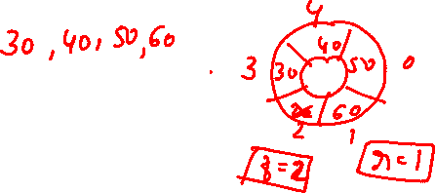

Slide 31
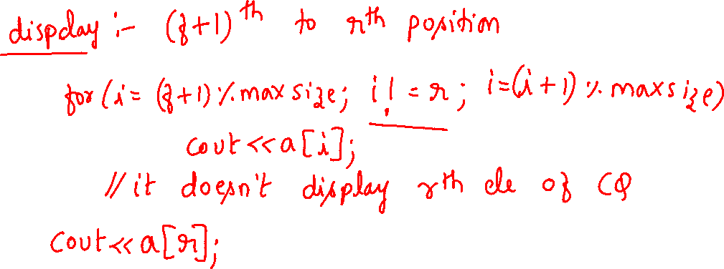

Slide 32
Circular Queue without counter: CQueue.cpp 1/3
Queue.cpp
#include<iostream.h>
#include<conio.h>
enum Boolean{FALSE,TRUE};
class cqueue
{ int front,rear, a[10], maxsize;
public: cqueue()
{ maxsize=8;front=rear=0;}
Boolean Isfull()
{
if((rear+1)%maxsize==front) return TRUE;
return FALSE;
}
Boolean Isempty()
{ if(rear==front) return TRUE;
return FALSE;
}
void add(int x);
void del();
void display();
};

Slide 33
Circular Queue without counter: CQueue.cpp 2/3
void cqueue::add(int x)
{ if(Isfull()) cout<<"Queue is full \n";
else{
rear=(rear+1)%maxsize;
a[rear]=x; }
}
void cqueue::del()
{ if(Isempty()) cout<<"queue is empty\n";
else{
front=(front+1)%maxsize;
cout<<"deleted element is"<<a[front]; }
}
void cqueue::display()
{ if(Isempty()) cout<<"Queue is empty\n";
else{
for(int i=(front+1)%maxsize;i!=rear;i=(i+1)%maxsize) //rear th element will not be displayed in for loop
cout<<a[i];
cout<<a[rear];
}//else
}

Slide 34
Circular Queue without counter: CQueue.cpp 3/3
void main()
{ cqueue s;
int option,ele;
char ch;
do{
clrscr();
cout<<"1.Insert\n2.Delete\n3.display\n4.exit\n";
cin>>option;
switch(option)
{
case 1: cout<<"enter the element to be placed in cq\n";
cin>>ele; s.add(ele);
break;
case 2: s.del();
break;
case 3: s.display();break;
}
}while(option<4);
}

Slide 35
Circular Queue with counter : Queue.cpp 1/4
Circular Queue
#include<iostream.h>
class queue
{
int a[10], front, rear, maxsize;
public:
queue()
{ maxsize=10; front=rear=-1; counter=0; }
queue(int m)
{ maxsize=m; front=rear=-1; counter=0; }
int Isfull()
{ if(counter==maxsize) return 1;
return 0;
}
int Isempty()
{ if(counter==0) return 1;
return 0;
}
void insert(int);
void del();
void disp();
};

Slide 36
Circular Queue with counter Queue.cpp 2/4
void queue::insert(int e)
{
if(Isfull())
cout<<"\nqueue is full";
else
{ rear=(rear+1)%maxsize;
a[rear]=e;
counter++;
cout<<"\nA["<<rear<<"]="<<e;
}
}
void queue::del()
{
if(Isempty())
cout<<"\nqueue is empty";
else
{
front=(front+1)%maxsize;
cout<<"element deleted is"<<a[front];
counter--;
}
}

Slide 37
Circular Queue with counter Queue.cpp 3/4
void queue::disp()
{
if(Isempty())
cout<<"Q is empty";
else
{
for(int i=(front+1)%maxsize;i!=(rear+1)%maxsize;i=(i+1)%maxsize)
cout<<a[i]<<"\t";
}
}

Slide 38
int main (int argc, char *argv[])
{
//clrscr();
queue q;int ch,m,ele;
cout<<"\nEnter the maximum size of the array:";
cin>>m;
q=queue(m);
do
{ cout<<"\n1.Insert\n2.Delete\n3.Display\n0.Exit"; cout<<"\nenter your choice:";
cin>>ch;
switch(ch)
{
case 1: cout<<"\nenter the element to be inserted:";
cin>>ele;
q.insert(ele);
break;
case 2: q.del();
break;
case 3: q.disp();
break;
case 0: break;
default: cout<<"\ninvalid input";
}
}while(ch!=0);
return 0;
}
Circular Queue with counter : Queue.cpp 4/4

